Slide 1

Machine Learning and Programming
Control Logic Synthesis for Manufacturing System using Meta Deep Reinforcement Learning
Project 8
Bogyeong Suh, Geon Kim, Sri Madhumitha Nelakanti, Tuli Barman
Final Presentation

Slide 2
1. Abstract
Background: Scheduling in manufacturing process is required for saving time and money. Especially for non-value adding tasks like Testing, an intelligent scheduling always becomes crucial.
Objective: Train deep reinforcement learning (DRL) algorithm to attain lower make-span for the entire process of testing the incoming products (pallets) than regular rule-based algorithms.
Methods: Deep Q-Networks with parallel training and customized reward function considering crowdness
Results: Our RL model showed 1,425 timesteps required to finish the procedure, beating the rule-based algorithms (1,548 and 1,546 timesteps for MIN and FCFS, respectively)
Conclusion: RL shows strength scheduling the crowdness of manufacturing process and can be used to shorten the overall make-span.

Slide 3
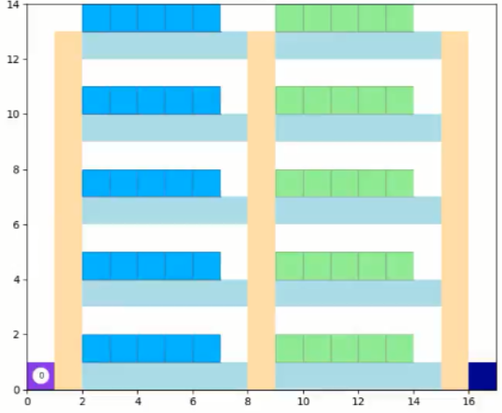
2. Introduction
Manufacturing systems in factories
The testing process environment consists of 2 sections: A and B; each with 5 floors and 5 testers on each floor
Basically the incoming pallets are first to be 1) tested on a tester from Section A, 2) tested on a tester from Section B, and 3) they head to exit
Section A
Section B
Lift
The incoming rate of pallets is considered to be varying.
Testing time of all the testers follow a normal distribution.
4th Floor
Tester A
Tester B
Entrance
Exit

Slide 4
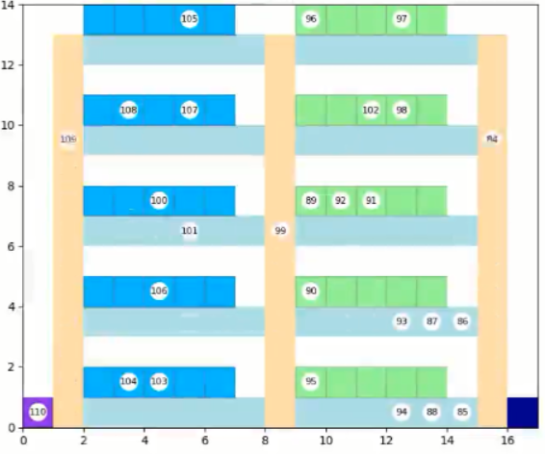
3. Problem Statement
The incoming pallets are assigned to a tester A (in Section A), then to a tester B (in Section B), while ensuring least waiting time and crowding possible.
Constraint: Any chosen location in the environment (Tester, Conveyor belts, Lift area) can only accommodate up to maximum 1 pallet at any instant.
Section A
Section B
Lift
4th Floor
Tester A
Tester B
A pallet taking the lift
Crowded floor
Entrance
Exit
The initial state
The crowded state

Slide 5
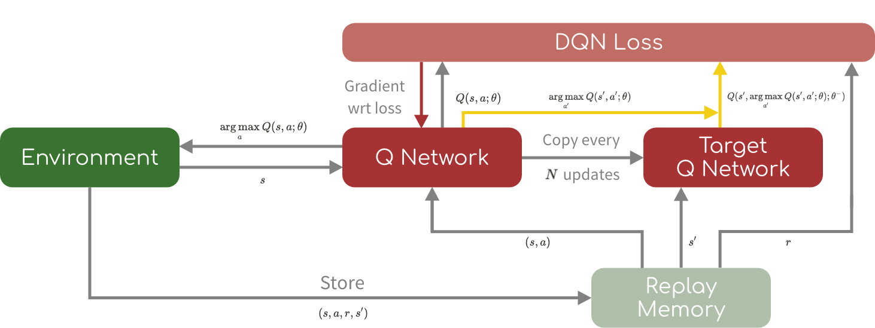
4. Methods
Deep Q Network (DQN)
-with Q Network and Target Q Network, learn action-value function minimizing DQN loss
Reinforcement Learning
States:
Status of all the testers and paths (occupied / idle)
Actions:
Floor selection (once each, for Section A and B)
DQN
state
reward
Action
Environment
Notes:
Q Network: Approximate action-value function
Target Q Networks: Separate networks
Replay memory: Get random pieces from the stack of history(memory)

Slide 6
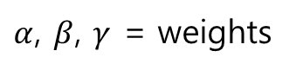
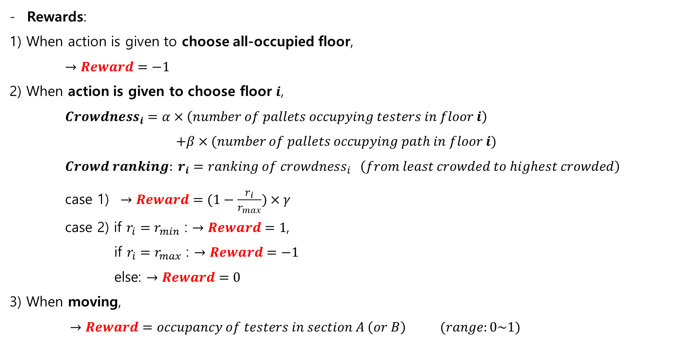
4. Methods
Rewards:
1) When action is given to choose all-occupied floor,
$→Reward=−1$
2) When action is given to choose floor $i$,
$Crowdness_{i}=α×\left(number of pallets occupying testers in floor i\right)$
$+β×(number of pallets occupying path in floor i)$
$Crowd ranking: r_{i}=ranking of crowdness_{i} \left(from least crowded to highest crowded\right)$
case 1) $→Reward=(1−\frac{r_{i}}{r_{max}})×γ$
case 2) if $r_{i}=r_{min}$ : $→Reward=1$,
if $r_{i}=r_{max}$ : $→Reward=−1$
else: $→Reward=0$
3) When moving,
$→Reward=occupancy of testers in section A \left(or B\right) (range:0\sim 1)$
$α$, $β$, $γ$ = weights

Slide 7
4. Methods
Parallel training (concurrent training)
-while sharing the same environment, two different models train concurrently
Section A
Section B
Section A
Section B
Model 1
Model 2
Reward
Environment
Action
Action
Model 1
Model 2
Section A: all pallets start from entrance
Section B: pallets’ starting points are different
Model 1: allocates pallets testing at section A
Model 2: allocates pallets testing at section B

Slide 8
5. Results
Performance results
Algorithms | Required timesteps
1. Rule-based algorithm: MIN | 1,548
2. Rule-based algorithm: FCFS | 1,546
3. RL with one model | 1,648
4. RL with two models (parallel training) | 1,597
5. RL with two models + customized reward function | 1,425
* MIN : Choose floors remaining the minimum number of pallets per floor
* FCFS: First-Come-First-Serve; Choose the lowest floor available (from the bottom to the top)

Slide 9
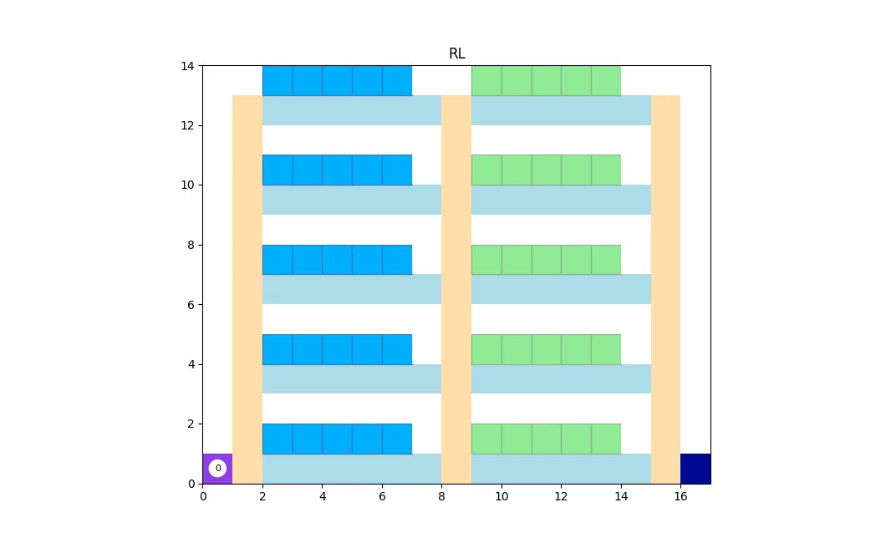
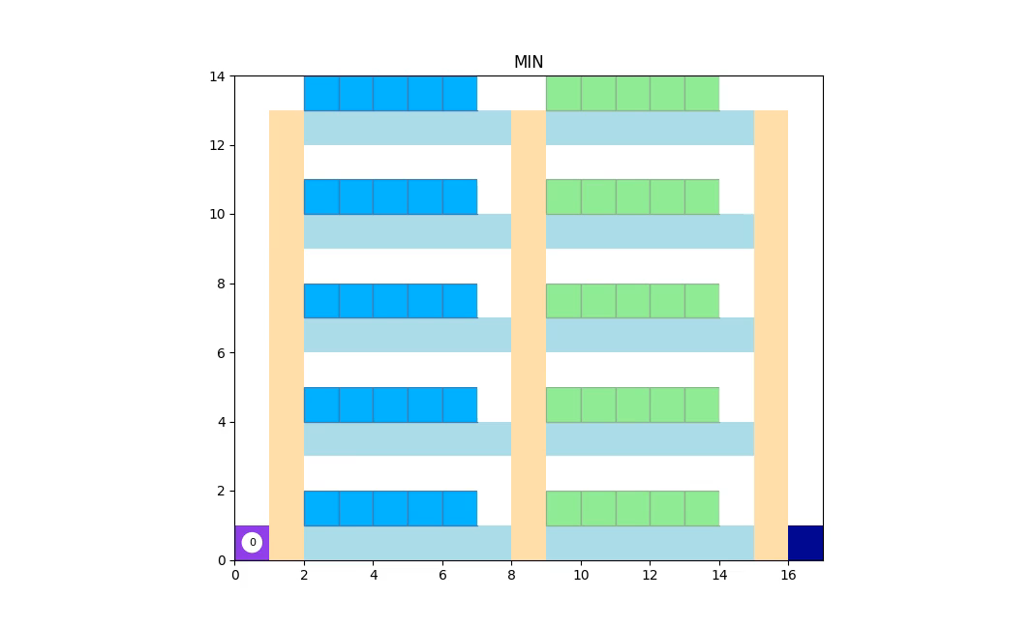

5. Results
Our RL model vs Rule-based algorithms (MIN, FCFS)
RL model
MIN
FCFS
Timesteps: 1,425
Timesteps: 1,548
Timesteps: 1,546

Slide 10
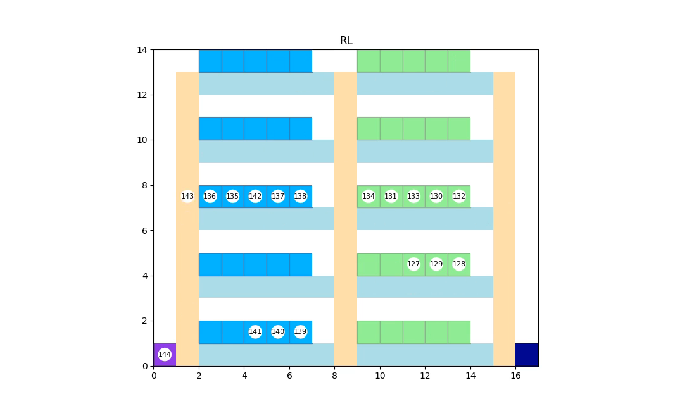
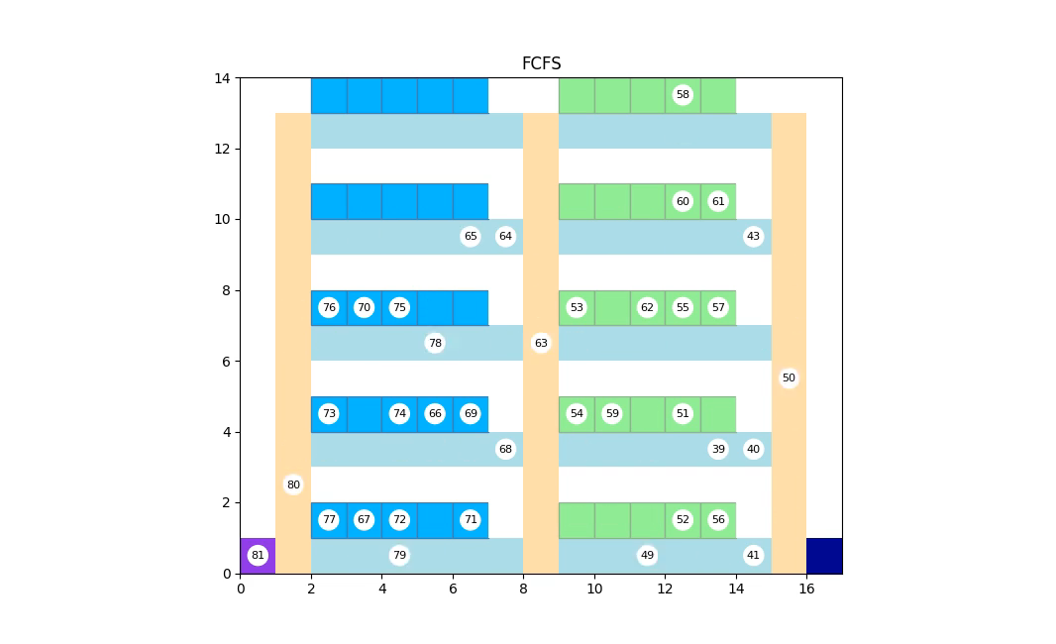
6. Discussion
Strength
-traffic jam due to lift resolved
-RL : tries to allocate pallets in section A to the same floor in section B
-MIN & FCFS : cannot allocate pallets to the same floor intentionally. → increased use of lift → waiting time↑
RL model
FCFS

Slide 11
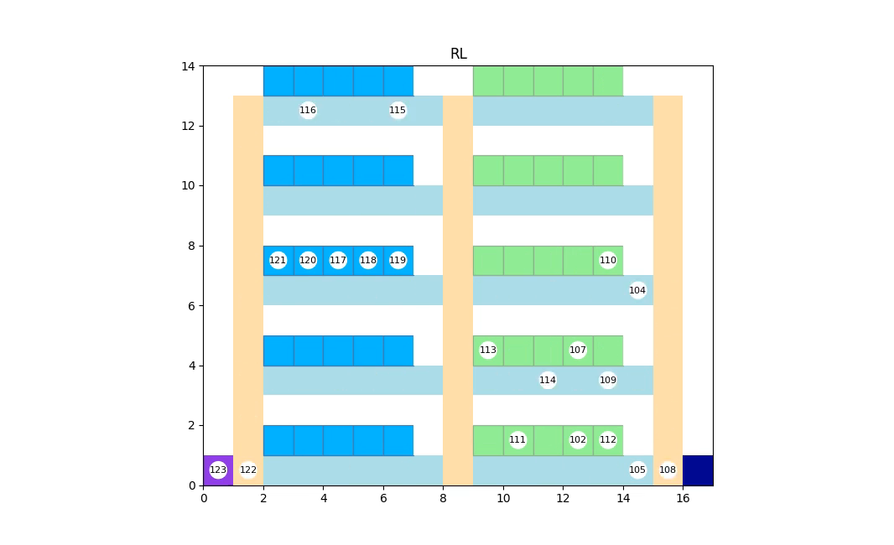
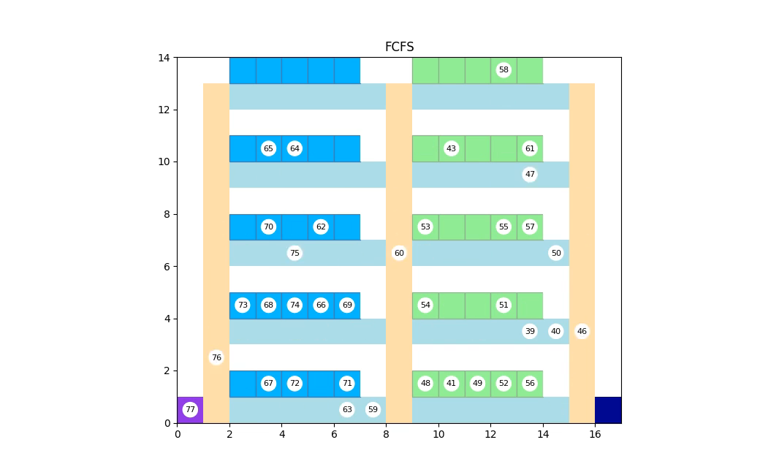
6. Discussion
Weakness
-less use of diverse floors
-RL : tries to use less number of floors
-MIN & FCFS : use all available floors if possible
→This can lead to wasted floors & increased time
All used
Not used
RL model
FCFS

Slide 12
6. Discussion
Limitation
1) Overgeneralized problem environment
Testing times can be considered more specifically
Speeds of motion of pallets can be considered
Malfunction of testers (although state of such testers can be set to forever occupied until they start functioning normally again)
2) Limitation of our reward function
- less crowdness does not guarantee the minimum procedure time

Slide 13
7. Conclusion
Contribution
-successfully trained a RL model recording lower tact time compared to the rule-based algorithms
-new reward functions considering crowdness
-parallel training of RL models
Future study
Improvement of reward function : terms relating required total procedure time
Consideration of 1) specific testing time, 2) speed of pallets, and 3) malfunction of testers

